Slide 1
WEB222
More on CSS, Page Layouts & Navigation

Slide 2
Announcements
Assignment 4 due soon (check myseneca)

Slide 3
Agenda
Part One
Box model
CSS margin, border, padding, shorthand
CSS3 shadow effects
CSS3 backgrounds
Part Two
Display / Positioning with CSS
HTML 5 Structural Elements
Bootstrap Grid Intro
Navigation / Menus

Slide 4
Part 1
Box model
CSS margin, border, padding, shorthand
CSS3 shadow effects
CSS3 backgrounds

Slide 5
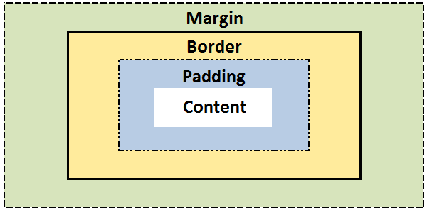
The CSS Box model
All elements can be considered to be box.
The box model is the specification that defines how a box and its attributes relate to each other.
A box is made up of four distinct parts:

Slide 6
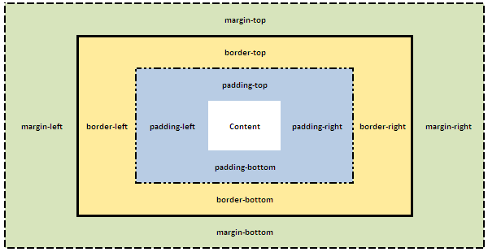
The CSS Box model – Detail
(See box-model.html example)

Slide 7
The CSS Box model – Shorthand
CSS Shortcuts allow for a property to have a single or multiple values.
Shortcuts/shorthand order: CLOCKWISE:
top -> right -> bottom -> left

Slide 8
The CSS Box Model – Margin
CSS Margins define the white space around an HTML element's border. See the "Box model".
CSS Centering Trick: "margin: 0 auto;" will center an element horizontally with an explicit width (ie: 300px)
margin | Applies to all sides
margin: 6px; /* this is a shortcut */ | Applies a margin to all sides of an element
margin-top | Applies a margin to the top of an element
margin-right | Applies a margin to the right of an element
margin-bottom | Applies a margin to the bottom of an element
margin-left | Applies a margin to the left of an element

Slide 9
The CSS Box Model – Margin Shorthand
To set all the margin properties in one declaration:
margin:10px 5px 15px 20px;
top margin is 10px
right margin is 5px
bottom margin is 15px
left margin is 20px
margin:10px 5px 15px;
top margin is 10px
right and left margins are 5px
bottom margin is 15px
margin:10px 5px;
top and bottom margins are 10px
right and left margins are 5px
margin:10px;
all four margins are 10px

Slide 10

The CSS Box Model – Margin Collapsing
Top and bottom margins of blocks are sometimes combined (collapsed) into a single margin whose size is the largest of the margins combined into it, a behavior known as margin collapsing.
h1 { margin: 0 0 25px 0; background: #cfc; }
p { margin: 20px 0 0 0; background: #cf9; }
http://www.sitepoint.com/web-foundations/collapsing-margins/

Slide 11
The CSS Box Model – Border
The border property allows for setting the width, style and color and of the borders around an element.
The border style property value for the border must be stated, otherwise no border will show up.

Slide 12
The CSS Box Model – border-width
The border-width Property
The border-width can be set in pixels, ems, or one of the three pre-defined values: thin, medium, or thick.
(See border-width.html example)
border-width | Applies to all sides
border-width: 6px; border-style: solid; | Applies a solid border to all sides
border-top-width | Applies only to the top border
border-right-width | Applies only to the right border
border-bottom-width | Applies only to all bottom border
border-left-width | Applies only to the left border

Slide 13
border-width Shorthand
(See border-short.html example)
Example | Description
border-width:6px; | adds a border - 6px to all four sides
border-width:6px 12px; | adds a border - 6px to top and bottom - 12px to the right and left
border-width:6px 12px 10px; | adds a border - 6px to the top, 12px to the right, 10px to bottom and 12px to the left
border:6px solid red; | width, style, color

Slide 14
The CSS Box Model – border-style
The border-style property
can have from one to four values from the list of
dotted , dashed , solid , double , groove , ridge , inset , outset , hidden.
(See border-style.html example)
border-style | Applies to
border-style:solid; /* default width of 3px */ | Applies a solid border to all sides
border-top-style | Applies the style only to the top border
border-right-style | Applies the style only to the right border
border-bottom-style | Applies the style only to all bottom border
border-left-style | Applies the style only to the left border

Slide 15
The CSS Box Model – border-color
The border-style property
(See border-color.html example)
border-color | Applies to
border-color:#ff0000; border-style: solid; | Applies a solid border to all sides
border-top-color | Applies only to the top border
border-right-color | Applies only to the right border
border-bottom-color | Applies only to all bottom border
border-left-color | Applies only to the left border

Slide 16
The CSS Box Model – border shorthand
Specify all the individual border properties in one property.
The border property is a shorthand for the following individual border properties:
border-width
border-style (required)
border-color
border: 5px solid red;

Slide 17
The CSS Box Model - padding
CSS Padding property defines the white space around the inside of an HTML element's border. See the "Box model".
(See box-padding.html example)
padding | Applies to all sides
padding:6px; /* this a short cut */ | Applies padding to all sides of an element
padding-top | Applies padding to the top of an element
padding-right | Applies padding to the right of an element
padding-bottom | Applies padding to the bottom of an element
padding-left | Applies padding to the left of an element

Slide 18
CSS3 Rounded Corners
Property: border-radius
Example:
(See boxShadow_roundedCorners.html example)
div {
border: 2px solid #a1a1a1;
padding: 10px 40px;
background: grey;
width: 300px;
border-radius:250px;
/* border-radius:10%; */
}

Slide 19
CSS3 Rounded Corners – Shorthand
border-radius: 2em;
is equivalent to:
border-top-left-radius: 2em;
border-top-right-radius: 2em;
border-bottom-right-radius: 2em;
border-bottom-left-radius: 2em;

Slide 20
CSS3 Box Shadow
CSS3 provides not only text-shadow but also box-shadow effects.
Property: box-shadow
box-shadow value: h-shadow v-shadow blur spread color inset;
(See boxShadow_roundedCorners.html example)

Slide 21
CSS3 Box Shadow
(see css-ball.html example)
box shadow generator: http://www.cssmatic.com/box-shadow
Value | Description
h-shadow | Required. The position of the horizontal shadow. Negative values are allowed
v-shadow | Required. The position of the vertical shadow. Negative values are allowed
blur | Optional. The blur distance
spread | Optional. The size of shadow
color | Optional. The color of the shadow. The default value is black. Look at CSS Color Values for a complete list of possible color values.
inset | Optional. Changes the shadow from an outer shadow (outset) to an inner shadow

Slide 22
background - Properties
background-image:
where image.jpg may be a relative or absolute path
background-color: can still be used, and will provide colour where the image is not displayed
background-position: values: left top (default), right bottom, center center
background-repeat: values: repeat (default), repeat-x, repeat-y, no-repeat
background-size: values: width (value), height (value), contain, cover
shorthand property:
(See bg.html example)
background-image: url(image.jpg);
body{ background: url("../img/seneca_logo.gif") no-repeat grey right top;}

Slide 23
CSS3 Backgrounds
Property "background-size": specifies the size of the background image.
Before CSS3, the background image size was determined by the actual size of the image.
In CSS3 it is possible to specify the size of the background image, which allows us to re-use background images in different contexts.
You can specify the size in pixels or in percentages.
If you specify the size as a percentage, the size is relative to the width and height of the parent element.

Slide 24
CSS3 Backgrounds
Resize a background image:
(See bg_new.html example)
body {
background:url(seneca_logo.gif);
background-size: 80px 60px;
background-repeat: no-repeat;
padding-top: 40px;
}

Slide 25
CSS3 Backgrounds
Stretch the background image to completely fill the content area:
(See bg_new_100.html example)
NOTE: background-size: contain; and background-size: cover; are also useful for stretching background images when the aspect ratio must remain the same
p {
background:url(NiagaraFalls.jpg);
background-size: 100% 100%; /* contain or cover works here too */
background-repeat: no-repeat;
padding-top: 40px;
}

Slide 26
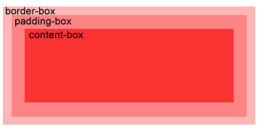
CSS3 Backgrounds
Property “background-origin”:
Specifies the positioning area of the background images.
The background image can be placed within the content-box, padding-box, or border-box area.
(See bg_new_origin.html example)

Slide 27
Part 2
Display / Positioning with CSS
HTML 5 Structural Elements
Bootstrap Grid Intro
Navigation / Menus

Slide 28
CSS – display Property
The display CSS property specifies the type of rendering box used for an element.
default value: inline
the value none lets you turn off the display of an element.
Example:
(See css_display.html example)
p.inline { display: none; }

Slide 29
The display Property Values
Value | Description
inline | Default value. Displays an element as an inline element (like <span>)
block | Displays an element as a block element (like <p>)
inline-block | Displays an element as an inline-level block container. The inside of this block is formatted as block-level box, and the element itself is formatted as an inline-level box
inline-table | The element is displayed as an inline-level table
list-item | Let the element behave like a <li> element
table | Let the element behave like a <table> element
table-caption | Let the element behave like a <caption> element
table-column-group | Let the element behave like a <colgroup> element
table-header-group | Let the element behave like a <thead> element
table-footer-group | Let the element behave like a <tfoot> element
table-row-group | Let the element behave like a <tbody> element
table-cell | Let the element behave like a <td> element
table-column | Let the element behave like a <col> element
table-row | Let the element behave like a <tr> element
none | The element will not be displayed at all (has no effect on layout)

Slide 30
Centering Lines Of Text
Centering lines of text in a paragraph or in a heading.
(See center_text.html example)
p { text-align: center }
h2 { text-align: center }

Slide 31
Centering a Block
Rephrase: left and right margin to be equal.
set the margins to 'auto'.
used with a block of fixed width.
(See center_block.html example)
div.center {
border: 2px solid red;
margin-left: auto;
margin-right: auto;
width: 400px;
}
<div class ="center"> … </div>

Slide 32
Positioning
CSS position property
can be used to position elements precisely in HTML pages.
a browser renders html statements in the order that they are in the html file - this is called normal flow

Slide 33
Positioning
Values for property: position
absolute - position precisely within the containing element
relative - position precisely relative to normal flow
fixed - position precisely within the browser window, and does not move when the page is scrolled
static - position using normal flow (default)
Values for Properties: "left", "right", "top", and "bottom" can be given offsets in px or %
NOTE: If you want to position a <div> using "absolute" positioning, relative to the parent element, the parent element cannot have be positioned using "static"
NOTE: Pay close attention to the "z-index" property when using position absolute
(See position.html & position_relative.html examples)

Slide 34
Positioning
What if the text takes more than the allotted space?
use the property "overflow" to specify an action:
{ overflow:scroll; } - include scroll bars
{ overflow:auto; } - scroll if required
{ overflow:hidden; } - hide overflow
{ overflow:visible; } – default
(See position.html example)

Slide 35
Positioning
Graphics and titles can be positioned in a similar fashion:
(see position_graphic.html example)

Slide 36
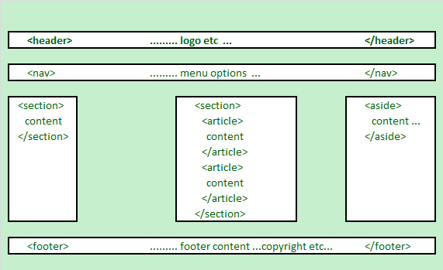
HTML5 Structural Elements
HTML 5 defines a number of new container elements for constructing documents.
header
nav,
section
aside
article
footer

Slide 37
HTML5 Structural Elements
Regarding <div> - The <div> element is the generic container for flow content, which does not inherently represent anything. It should be used only when no other semantic element (such as above elements) is appropriate.
Elements | Description
<header> | the web page/site header content
<nav> | the navigation functionality for the page/site.
<section> | the grouping of related subjects on the web page.
<main> | the main content on the web page.
<article> | contains a standalone content on the web page.
<aside> | used for content that's not central to the web page.
<footer> | the web page/site footer content

Slide 38
HTML5 Structural Elements
<body>
<header>......... logo etc ... </header>
<nav>......... menu options ... </nav>
<section id="sidebar1">......... section 1 ... </section>
<section id="main"><!-- may be replaced by main element -->
<article>article within the section </article>
<article>another article within the section </article>
</section>
<aside>......... aside content ... </aside>
<footer> ......... footer content ...copyright etc ... </footer>
</body>

Slide 39
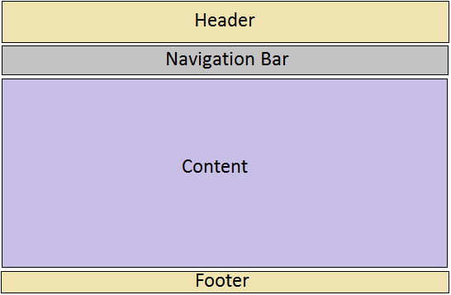
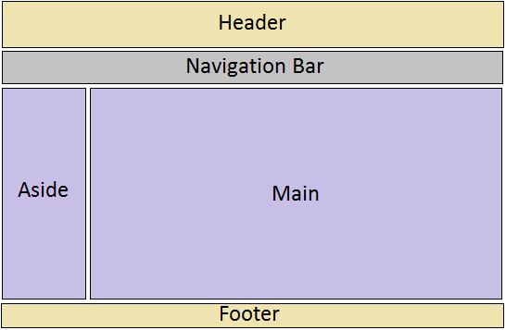
Web Page Layouts
One-column Layout
(See layout-1-column.html example)
Two-Column Layout
(See layout-2-column.html example)

Slide 40
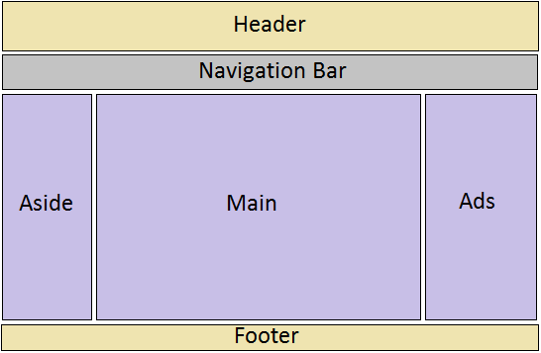
Web Page Layouts
Three-column Layout
(See layout-3-column.html example)

Slide 41
Bootstrap's Responsive Grid
(TODO – INTRO NOTES EXPLAINING BOOTSTRAP'S GRID:
https://cdn.rawgit.com/WEB222-Samples/Utilities/master/bootstrap-md-grid/bootstrap-md-grid.css using col-md-1…col-md-12 & row / container classes)
(TODO – Update examples to use bootstrap-md-grid)

Slide 42
Create Layouts with HTML5 and CSS3
Creating 2-column fluid (float-based) layouts with CSS
Set the width of an outer container (e.g. 960px) and center the element:
Set the width of the inner “aside” block and float it to left:
Set the width of the “main” section and float it to left:
.container { width: 960px; margin: auto; }
aside { width: 192px; float: left; }
section.main { width: 768px; float: left; }

Slide 43
Create Layouts with HTML5 and CSS3
Set the clear property of the footer to ‘both’:
Set margin, border, padding, background-color, … to each structural element, e.g.:
Note: You can also use relative widths for the page and columns (ie, completed Lab 3)
footer { clear: both; background-color: #444; }
aside, section.main {margin-top: 58px; margin-right: 10px; margin-left: 10px; }

Slide 44
Navigation and Menus
Web page navigation
convert the unordered the list a navigation bar or menu.
<nav>
<ul>
<li><a href="#top">Home</a></li>
<li><a href="#timetable">Timetable</a></li>
<li><a href="#standards">Standards</a></li>
<li><a href="ibc233/ibc233.html">IBC233</a></li>
<li><a href="web222/web222.html">WEB222</a></li>
<li><a href="bti220/bti220.html">BTI220</a></li>
</ul>
</nav>

Slide 45
Navigation and Menus
Single Level Menu Options
Horizontal Single Level Menu - (See menu-single-level-horizontal.html example)
Vertical Single Level Menu Example – (See menu-single-level-vertical.html example)
Multi Level Menu Options
Horizontal Multi Level Menu Example – (See menu-multi-level-horizontal.html example)
Vertical Multi Level Menu Example – (See menu-multi-level-vertical.html example)

Slide 46
Updating Menus using the DOM
(TODO – SHORT EXAMPLE OF UPDATING MENUS USING THE DOM)

Slide 47
Useful Links
CSS Reference
http://reference.sitepoint.com/css
Box model - CSS | MDN
https://developer.mozilla.org/en-US/docs/Web/CSS/box_model
CSS Properties
http://reference.sitepoint.com/css/propertyref
CSS Selectors
http://reference.sitepoint.com/css/selectorref

Slide 48
Questions?
Any questions?
Would you like to see any more examples?

